Slide 1
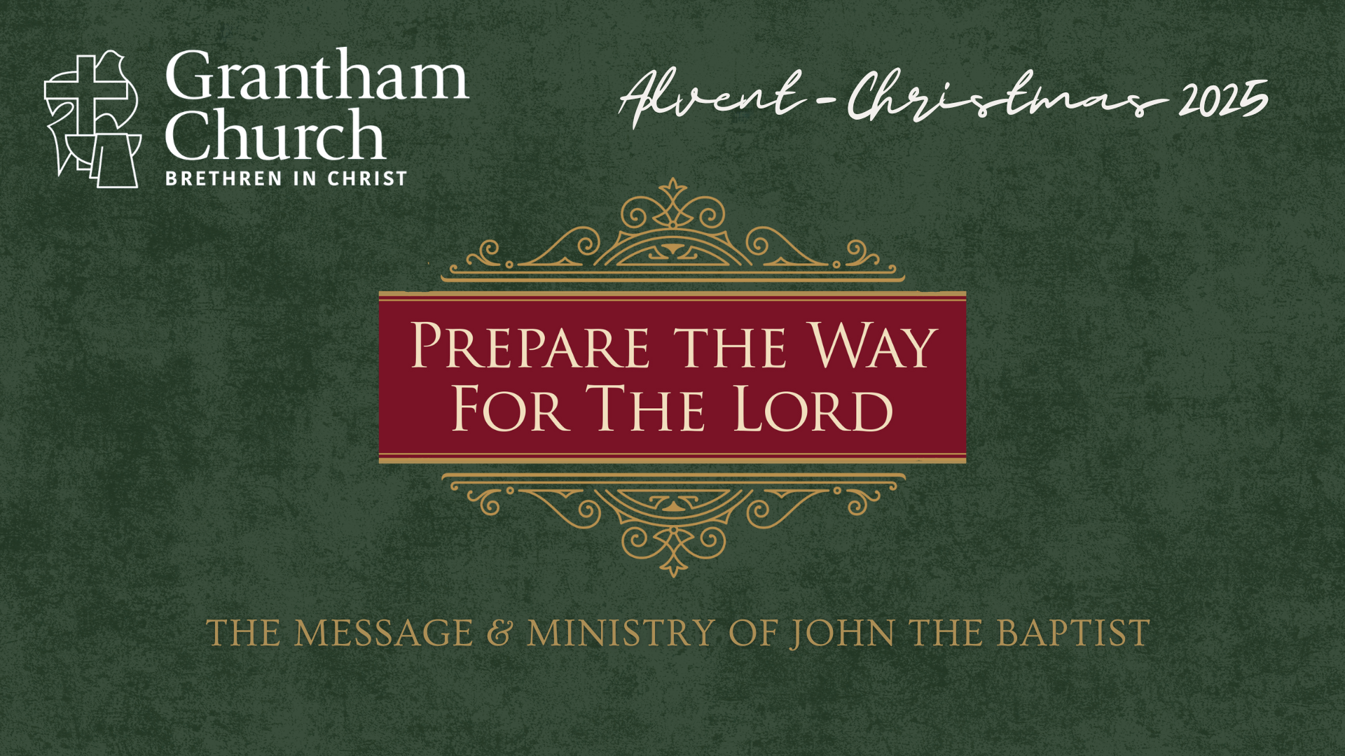
Notes:
[BRIEF INTRO]
Preparing for the birth of a child
Advent – from the latin, adventus – which means coming, arrival, or presence
In the ancient world, rulers would announce their adventus before making official visits to cities (e.g., a messenger would be sent ahead to prepare the people; folks would clean up their homes, repair the streets, decorate, etc.)
In the church, Advent is about preparing for the coming of Christ
And so, this Advent season, we’re going to journey with John the Baptist—the prophet who prepared the way for Jesus’ coming. Through his message of repentance, grace, and renewal, we’ll discover what it means to prepare our hearts for Christ’s arrival and to live as witnesses of his light. Each week invites us deeper into the hope, peace, joy, and love of Advent, leading to the celebration of Christ’s birth and the call to let his life increase in us.
And if you’re interested, the inspiration of this Advent to Christmas series has come from… [NEXT SLIDE]

Slide 2
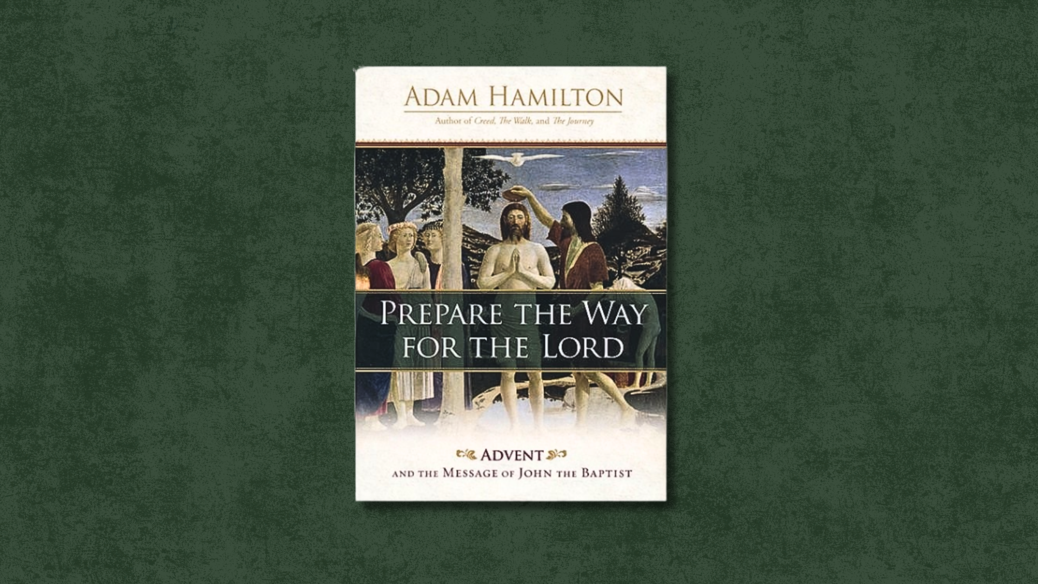
Notes:
Adam Hamilton’s book, Prepare the Way for the Lord, which you can purchase through Amazon and use it to reflect more deeply on what we will be covering, and as a form of devotional reading to help you focus on the meaning of this season.
We are beginning our series this morning with the message… [NEXT SLIDE]

Slide 3

Notes:
A People Prepared for the Lord.
And now, please grab your Bible and open up to our primary Scripture reading for the first Sunday of Advent… [NEXT SLIDE]

Slide 4

Notes:
[INVITE PEOPLE TO STAND & READ MATTHEW 6:1-4 NIV]
This is the word of the Lord. Thanks be to God. You may be seated.
It’s no secret that I like movies
Theology in the Movies project
As a pastor and theologian, I’m particularly interested in movies and tv shows related to the Bible; how close do they stick to history and the narrative of the Scriptures, the liberties they take to fill in the gaps, and the way biblical characters are portrayed
John the Baptist is always an interesting one. Check out these pictures… [NEXT SLIDE]

Slide 5
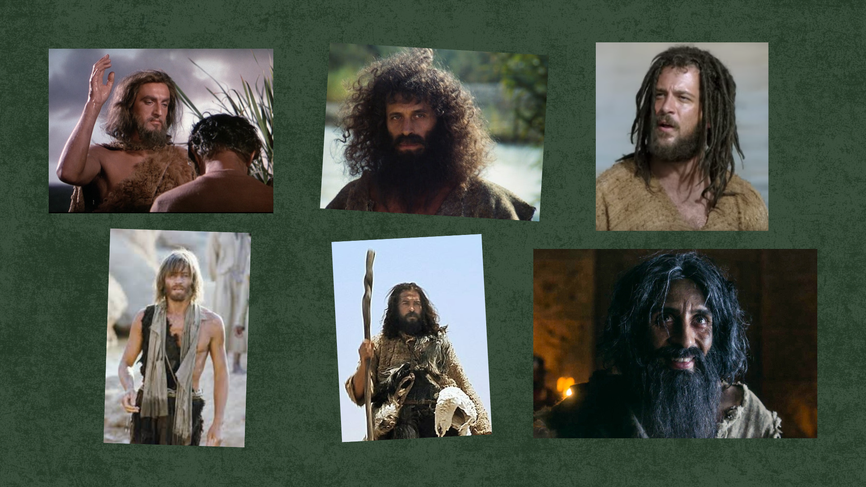
Notes:
[BRIEF COMMENTS ON PICS]
What do we know about John the Baptist? Well, as we will see in this series, we know that he was the cousin of Jesus; born just a few months before the Lord to Elizabeth, who was beyond her child-bearing years. We know that his birth was foretold by an angel to his father, Zechariah—a priest. And the angel also said that John would be a forerunner to the Messiah, the Son of God. He said that John would “prepare the way of the Lord.” We’re also told in the Gospels that John was a prophet living out in the wilderness and preaching along the Jordan river. His message was fiery and his clothes were a garment made of camel’s hair and a belt made of leather—a humble material reflective of his prophetic calling and ascetic lifestyle. And he ate insects, which he washed down with some raw, unprocessed honey.
Now, what sort of person would live and look like that? Well, I think it’s safe to say that they’re probably a bit eccentric, which is why John the Baptizer is often portrayed the way he is in film and streaming shows. So, maybe The Chosen gets it right in their portrayal of the prophet as “Creepy John.”
And as we read earlier, John is preaching out in the Judean wilderness and baptizing folks in the Jordan River… [NEXT SLIDE]

Slide 6
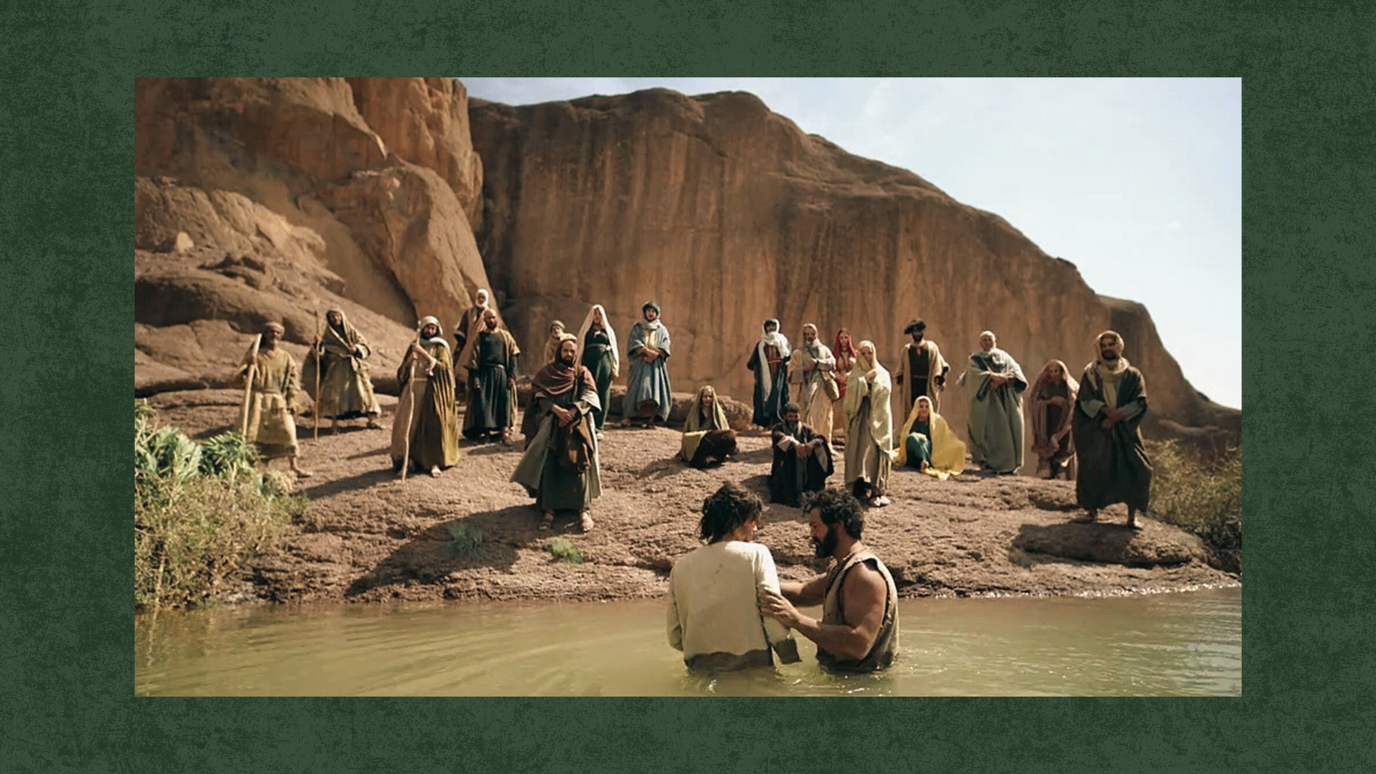
Notes:
At the heart of his message is, “Repent, for the kingdom of heaven is coming”—it’s close, it’s about to arrive, it’s come near. Again, just like an imperial messenger would go out ahead of royalty, John the Baptist sees himself as the one who is to announce the coming of the true King of Israel—the Messiah, the Son of God. And while his call for the people to repent (to turn around; to change) did involve personal sins, it’s also a wake-up call for the whole of Israel to repent of their idolatry and of the worldly mind; and to repent of the increasing division, hate, and movement toward violent revolution. As you know, Jesus himself will later lament Israel’s refusal to repent of these things in Matthew 23, which eventually provokes the Romans to war and bloodshed, and brings about the destruction of Jerusalem and the scattering of the Jewish people.
And think with me… what thoughts and images are being conjured up in the minds of the crowds who are going out to meet John in the wilderness? Well, quite a few things, actually. In the OT book of Exodus, the wilderness is where the people of God escape to from Egypt—from oppressive empire. It’s a retreat from the hustle and bustle of society, from the idols of empire, and from the slavery of the work week without a Sabbath. The wilderness offered them (and us today) a space to meet with God and to learn to trust him. While it may be hot, dry, and barren out in the desert, the wilderness quickens our spiritual senses and allows us to hear the voice of God over the cacophony of voices vying for our attention and allegiance; to hear the voice of God over the news and noise of the world. And God uses John the Baptist to be the voice of one calling in the wilderness.
Also, if you go back to say Deut. 30, you can read about the children of those who wandered around in the wilderness for 40 years. This new generation is by the Jordan river, waiting to go in to the promised land. They grew up in the wilderness, saw the faithlessness of their parents, heard their grumbling and complaining—even their murmuring about the “good ole days” in Egypt, where they at least had food on the table and a roof over their heads. And so, this younger generation has been shaped by the wilderness and are ready to be used by God to do a new thing. Therefore, this new exodus of God’s covenant people will pass through the waters of the Jordan—the waters of cleansing, purification, of surrender, and of salvation. Therefore, the baptism administered by John symbolized this: God doing a new thing and preparing his people to enter the promised land and follow the way of the Messiah.
And the prophet Malachi at the end of the OT, prophesied these words about John the Baptist… [NEXT SLIDE]

Slide 7
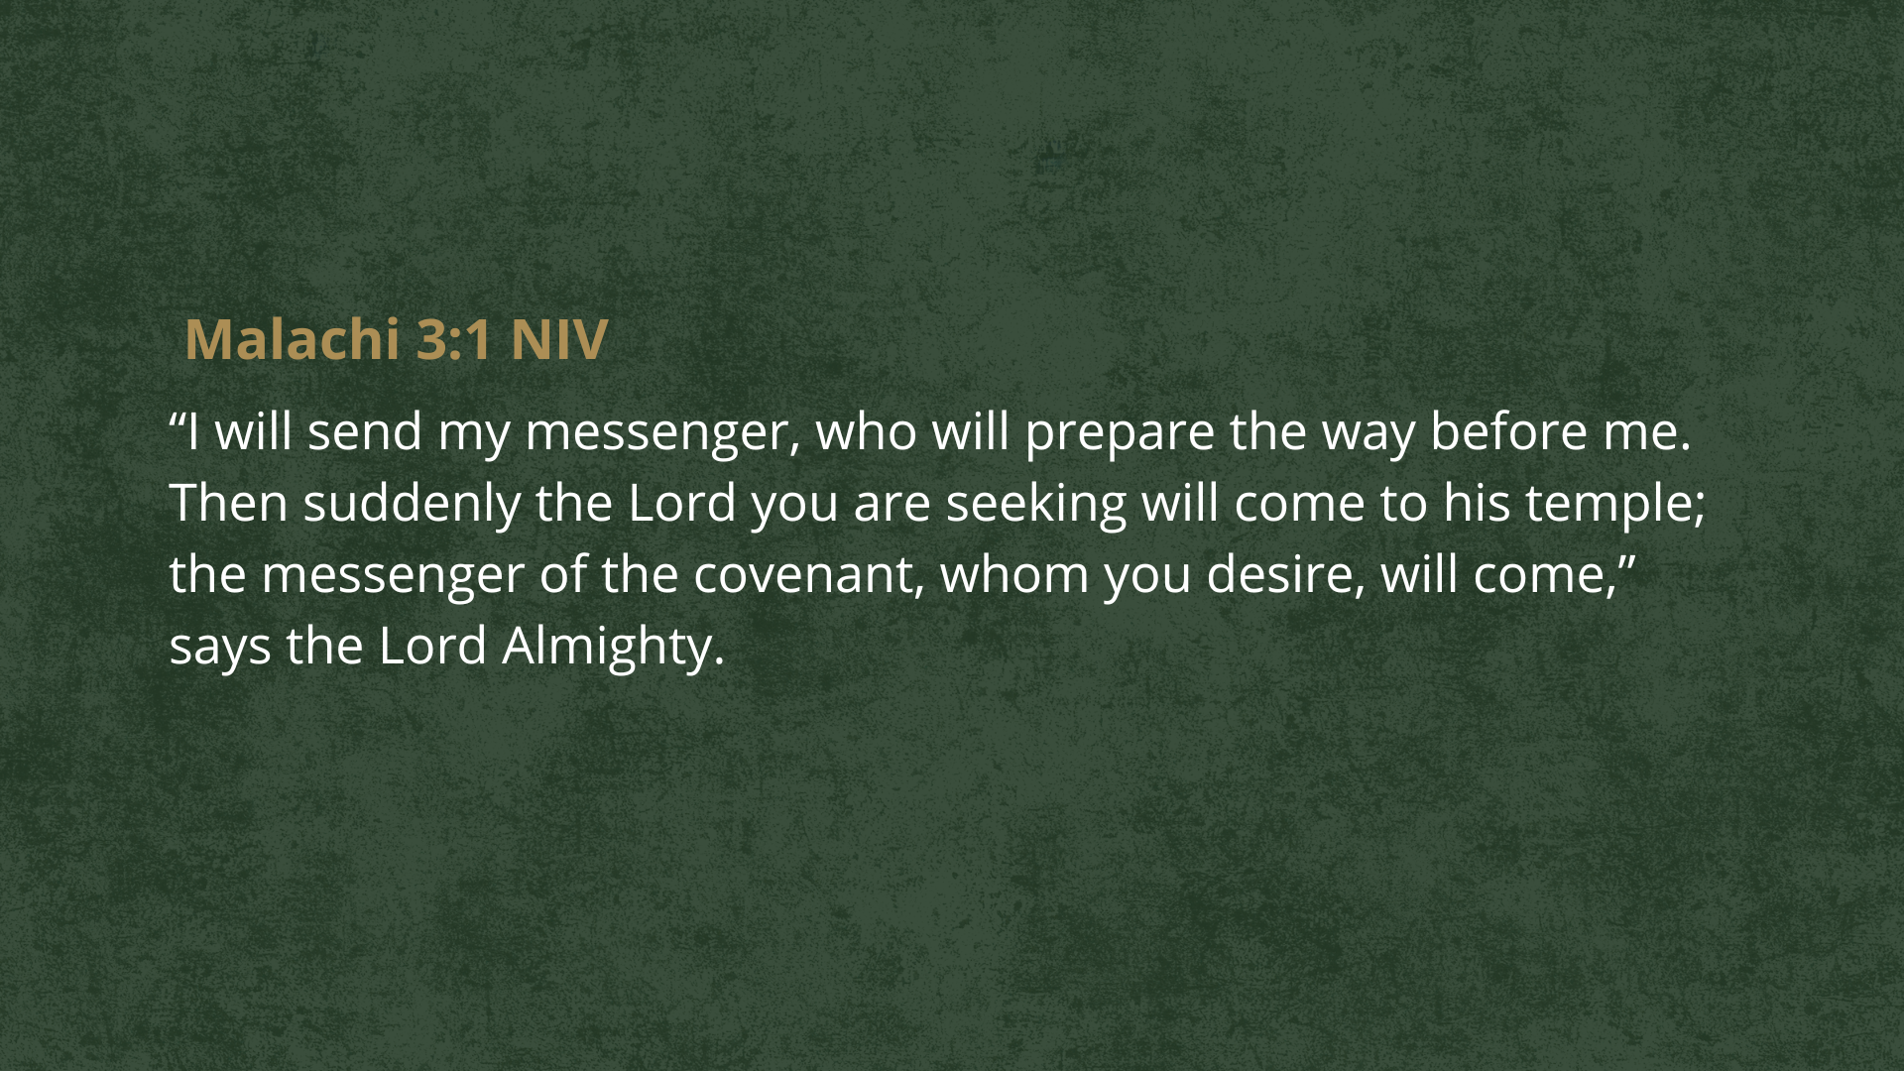
Notes:
[READ & COMMENT]
”The Lord you are seeking will come to his temple.” This was the hope of Israel—God’s presence returning to the Temple is the way they envisioned the Kingdom coming to earth. In the age of Messiah, God’s power and presence will come down and rest in the Temple and he will reign over all the earth. And through this Temple, God’s Spirit will draw all nations to his throne to worship him and know that he alone is God. And of course, in the gospels, Jesus reveals himself to be the true Temple and the way by which people come to know and worship the God of the universe.
But again, there is a condition for God’s Spirit to come and fill us, our churches, and our community with more of himself. And we can hear in this prophecy of Malachi a description of “the messenger” (John the Baptist) who issues a call to repent; to get your heart right; to prepare the way for a special filling of God’s presence.
In 2 Chronicles 29, we see an example of this preparation in the OT story of King Hezekiah… [NEXT SLIDE]

Slide 8
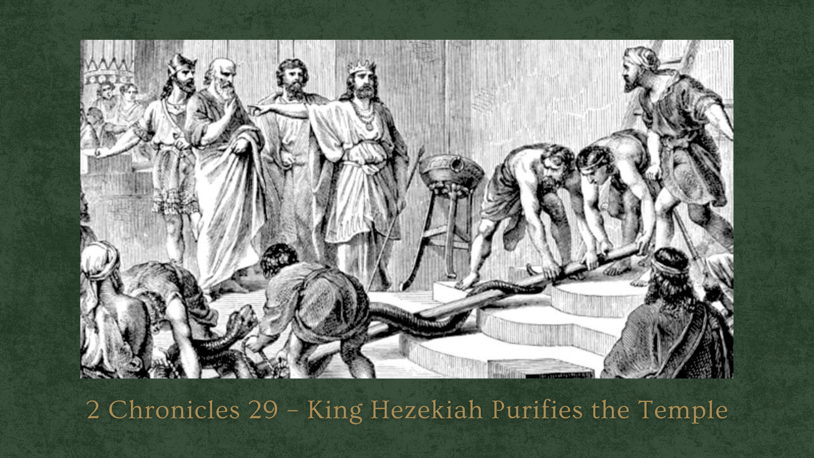
Notes:
When Hezekiah, a righteous king, came to the throne of Judah, the nation was spiritually dry and disordered. His father, Ahaz, had closed the doors of the temple, extinguished the lamps, and allowed the worship of Yahweh to become polluted and collapse into neglect. Yet, despite Ahaz’s idolatry, many people still believed in God, but the path to Him was cluttered with idolatrous compromise and distractions of the world. So, on the very first month of his reign, King Hezekiah called the priests and Levites together and said: “Now consecrate yourselves and consecrate the temple… Remove all defilement from the sanctuary” (29:5). And he goes on to essentially say, “Our parents were unfaithful…. but we will repent and worship God alone.”
What came next was a deliberate, laborious act of preparation. For sixteen days the priests carried out idols, restored the sacred vessels, repaired the doors, and reopened the temple. It wasn’t glamorous or fun, but it was necessary work. It was “clearing space”—physically and spiritually—so that worship could be renewed. And when the cleansing was complete, Scripture says: “The service of the temple of the LORD was reestablished… and there was great joy in Jerusalem” (29:35-36).
Friends, Hezekiah’s story is Advent-shaped: Before renewal and an awakening came, preparation had to come from the people of God. Before joy returned, the temple had to be cleared. Before the presence of the Lord was renewed, the people had to “prepare the way.” And that is what the Spirit is inviting us into during Advent: intentional preparation for God to reveal more of himself, and to deepen our faith in the only one who can save us.
So, how do we prepare for that? [NEXT SLIDE]

Slide 9
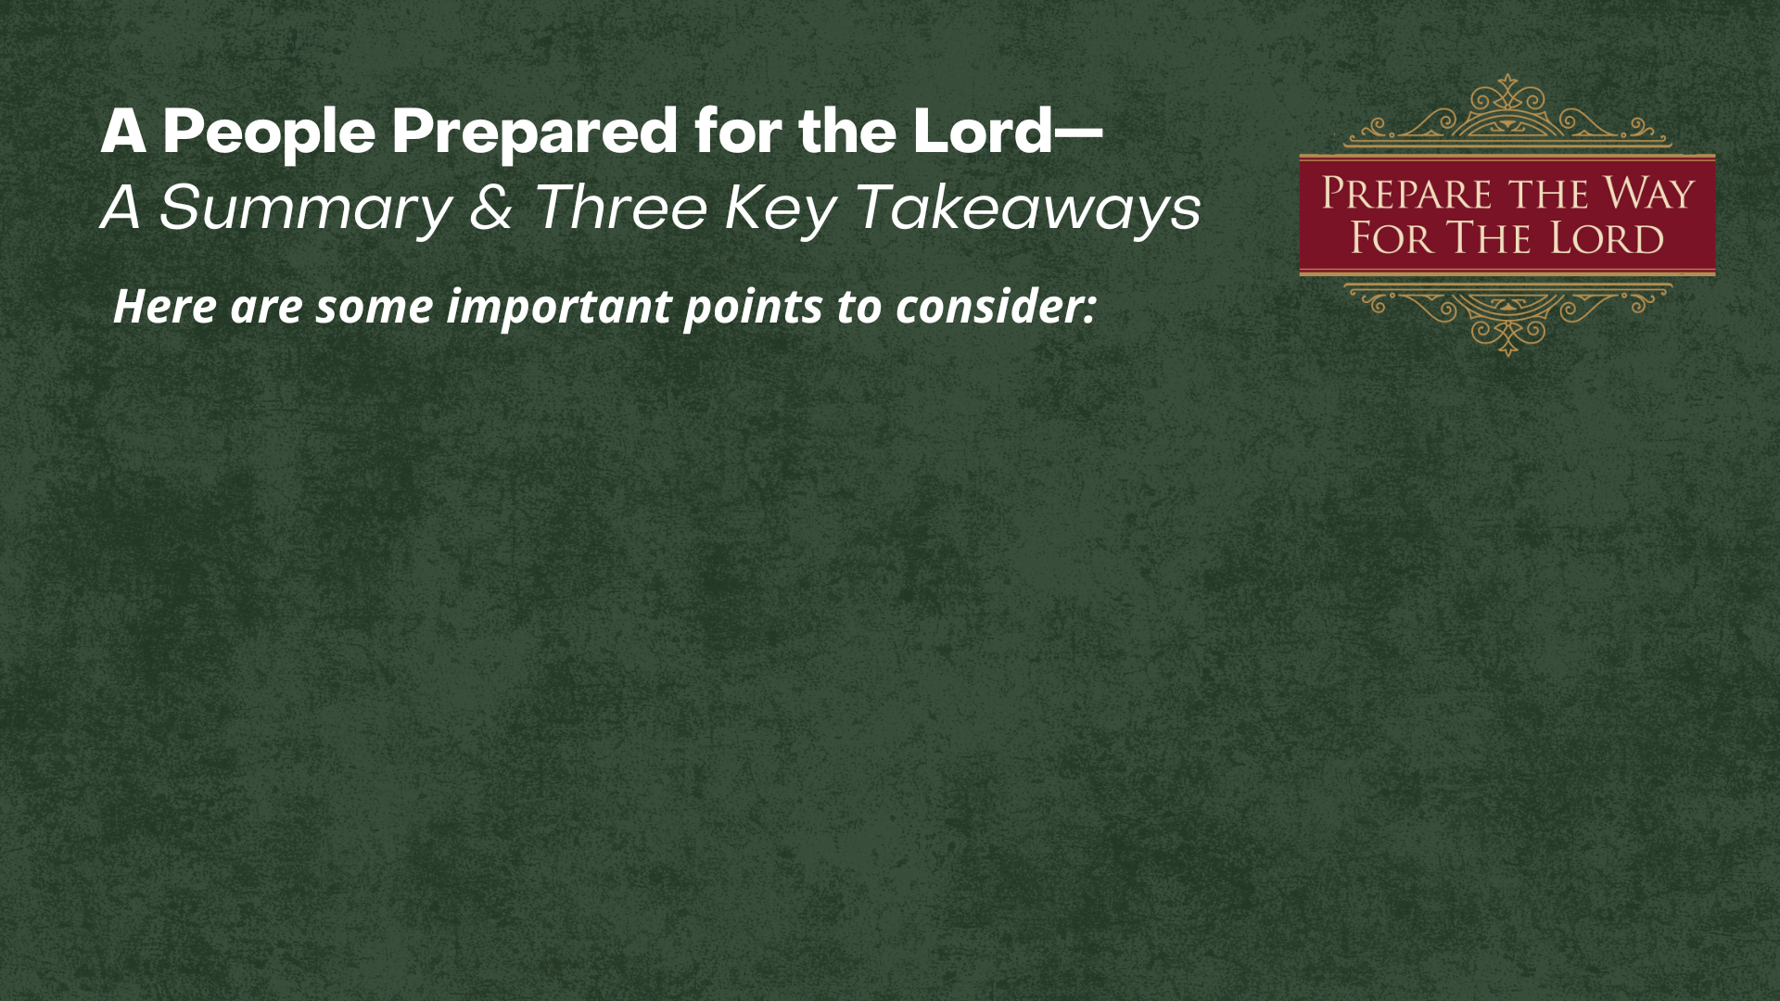

Slide 10
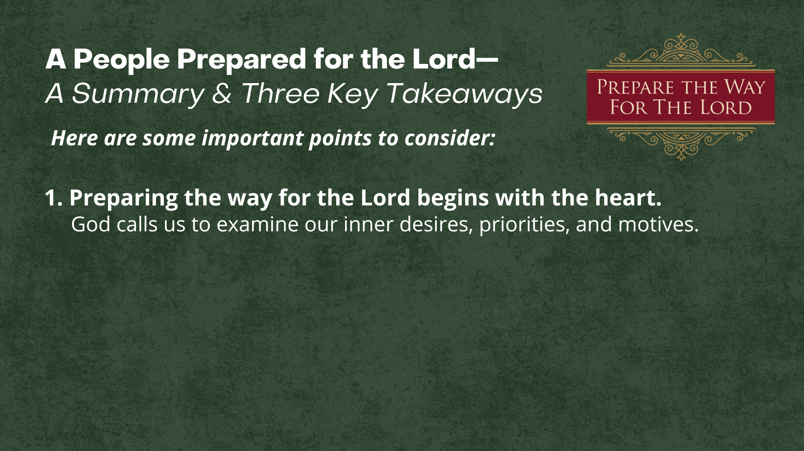

Slide 11
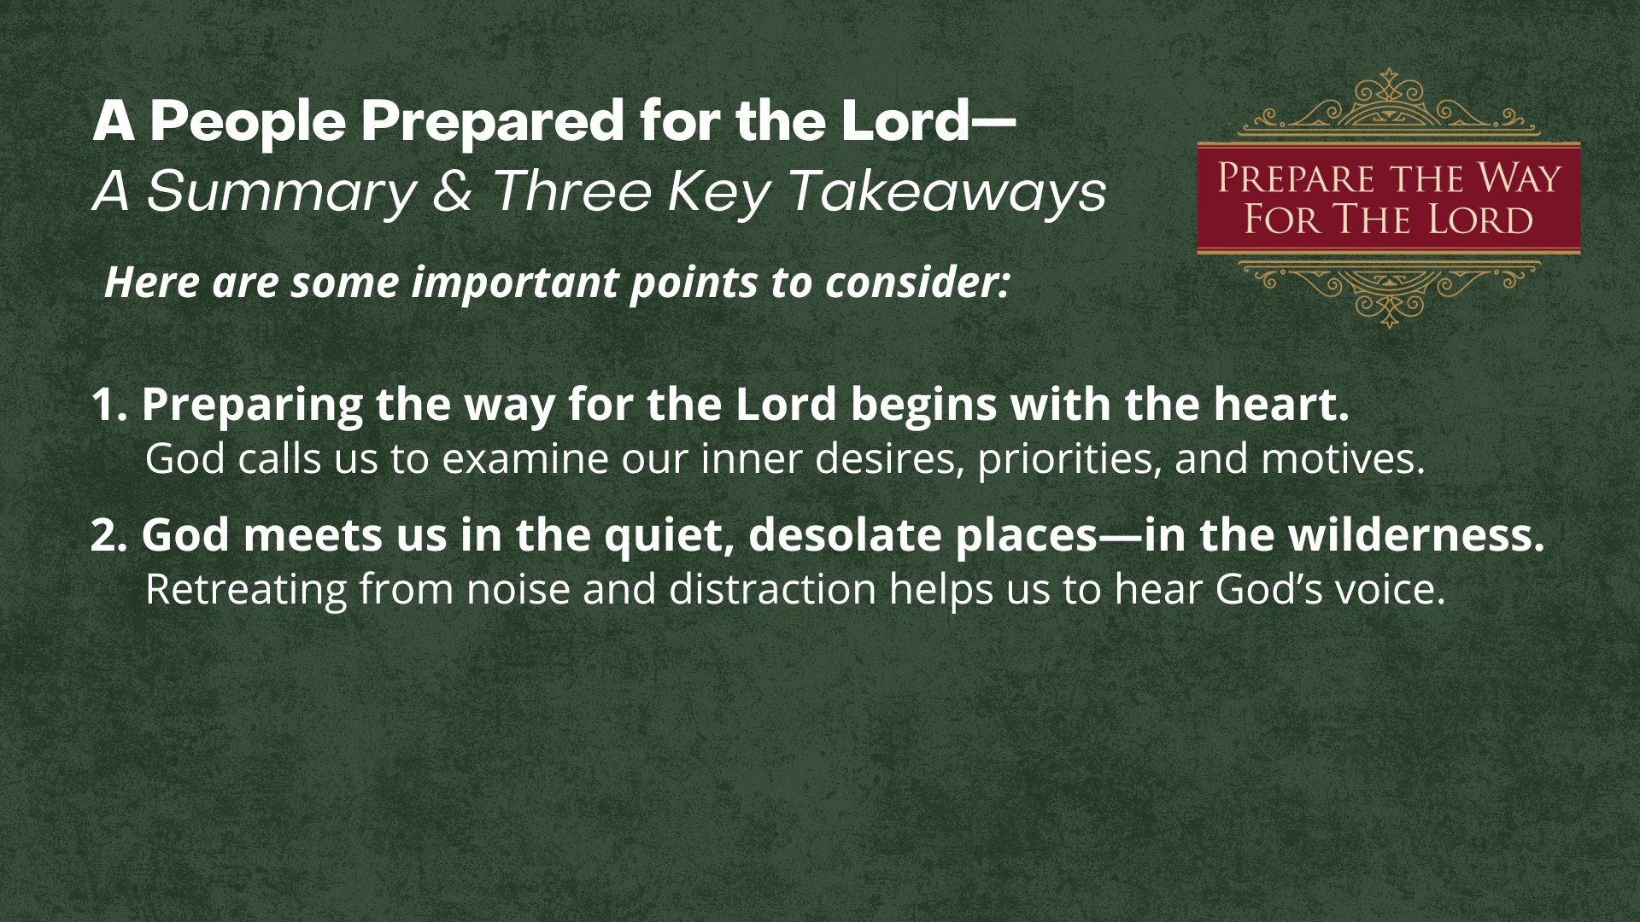

Slide 12
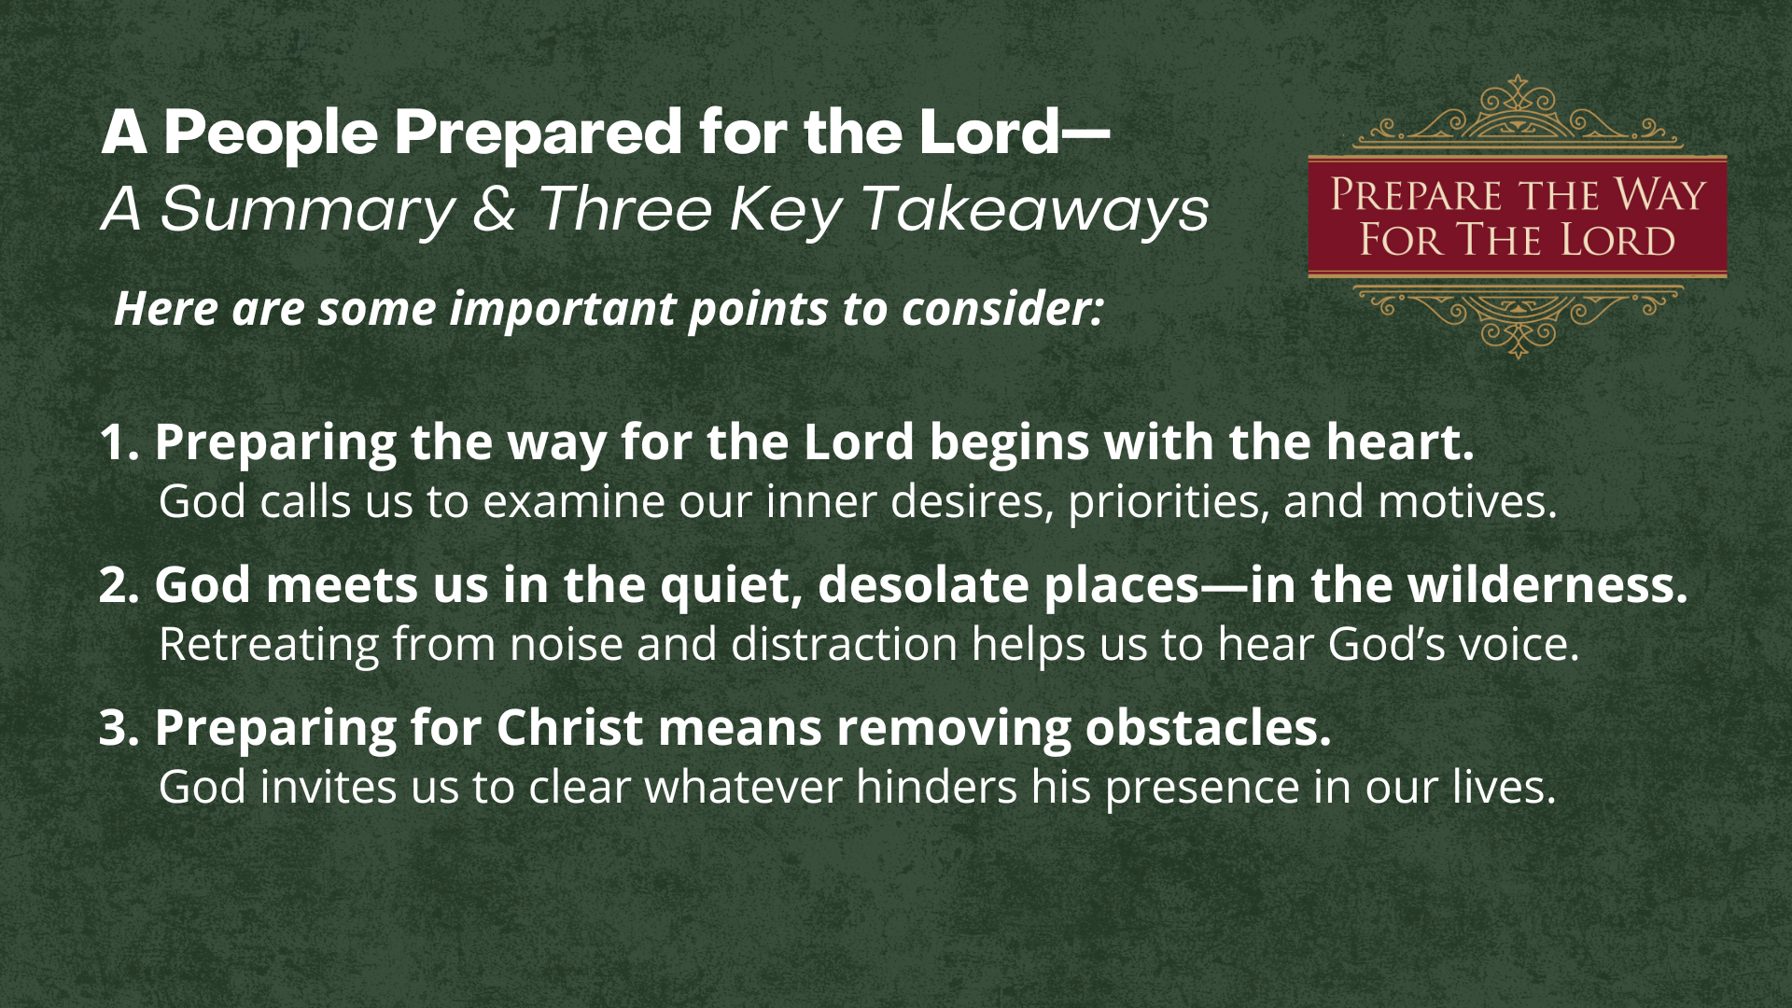
Notes:
[READ TAKEAWAYS & COMMENT BRIEFLY]
1. Preparing the way for the Lord begins with the heart.
God calls us to examine our inner desires, priorities, and motives.
2. God meets us in the quiet, desolate places—in the wilderness.
Retreating from noise and distraction helps us to hear God’s voice.
3. Preparing for Christ means removing obstacles.
God invites us to clear whatever hinders his presence in our lives.
Brothers and sisters, John’s cry in the wilderness invites us to prepare the way of the Lord in our own hearts. It means getting our house in order and doing whatever is necessary to align ourselves with God’s will and way. The season of Advent begins in longing and repentance—a clearing of the carnal clutter that hinders Christ’s coming. Advent is not for passive waiting; it’s for active preparation. And while it’s fun to decorate our homes in this season (and a great reminder that we are preparing for the coming of the light), let’s be sure we do more than ready our homes with Christmas décor, let’s prepare our hearts for the coming of the Lord as we journey through Advent together and look forward to the joy of Christmas. Amen?
Finally, here are some questions to help us reflect and then respond to the message… [NEXT SLIDE]

Slide 13
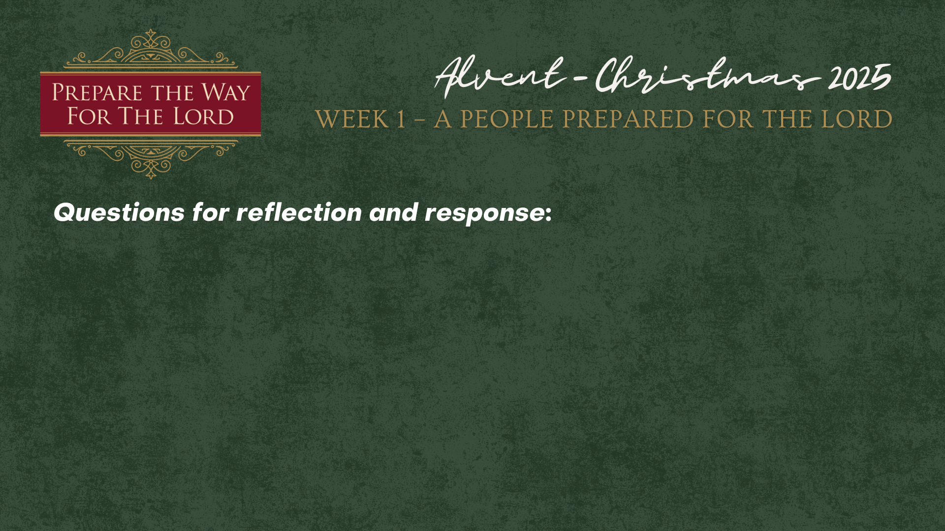

Slide 14
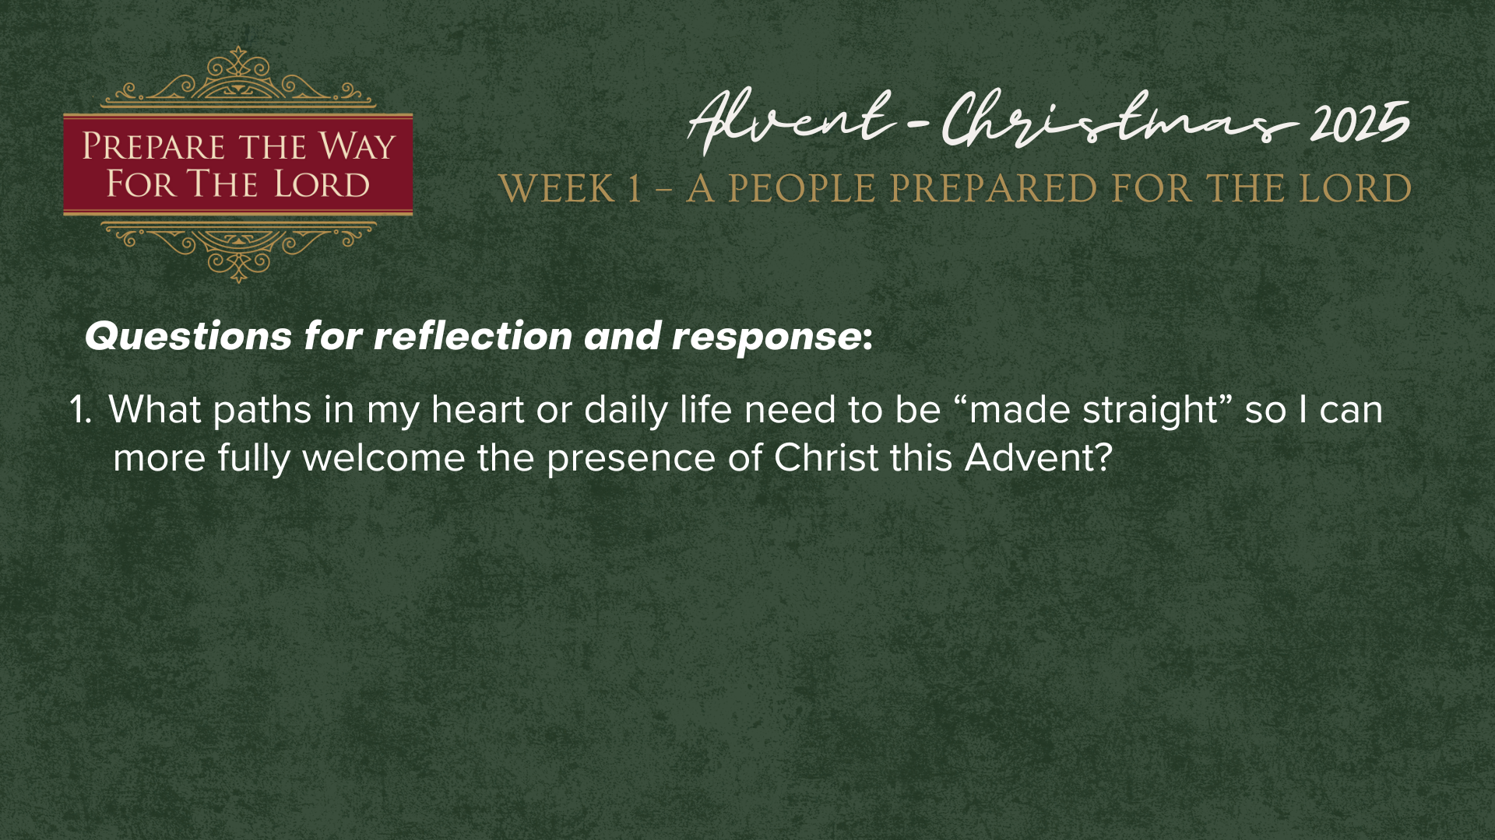
Notes:
[READ & BRIEF COMMENT ON EACH QUESTION]
What paths in my heart or daily life need to be “made straight” so I can more fully welcome the presence of Christ this Advent? Is there any carnal clutter or issues you need God to help you with?
Second question… [NEXT SLIDE]

Slide 15
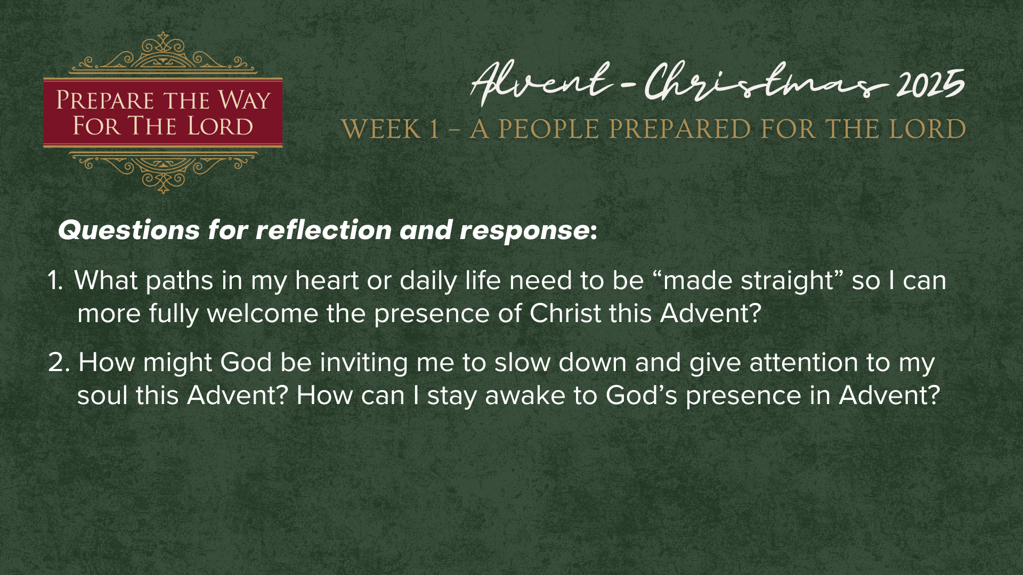
Notes:
[READ QUESTION & COMMENT]
2. How might God be inviting me to slow down and give attention to my soul this Advent? How can I stay awake to God’s presence in Advent?
I’d like to invite you to consider some of these options… [NEXT SLIDE]

Slide 16

Notes:
[BRIEF COMMENTS ON EACH]
Subscribe to devotionals from Biola University’s Center for Christianity, Culture, and the Arts
Pray as You Go – perfect for those with a commute to work
Lectio 365 - lectio divina (reflecting on Scripture & inviting you into prayer – morning, midday, and evening)
Lectio for Families – great for families to do in the morning or around bedtime
And lastly, question number 3… [NEXT SLIDE]

Slide 17
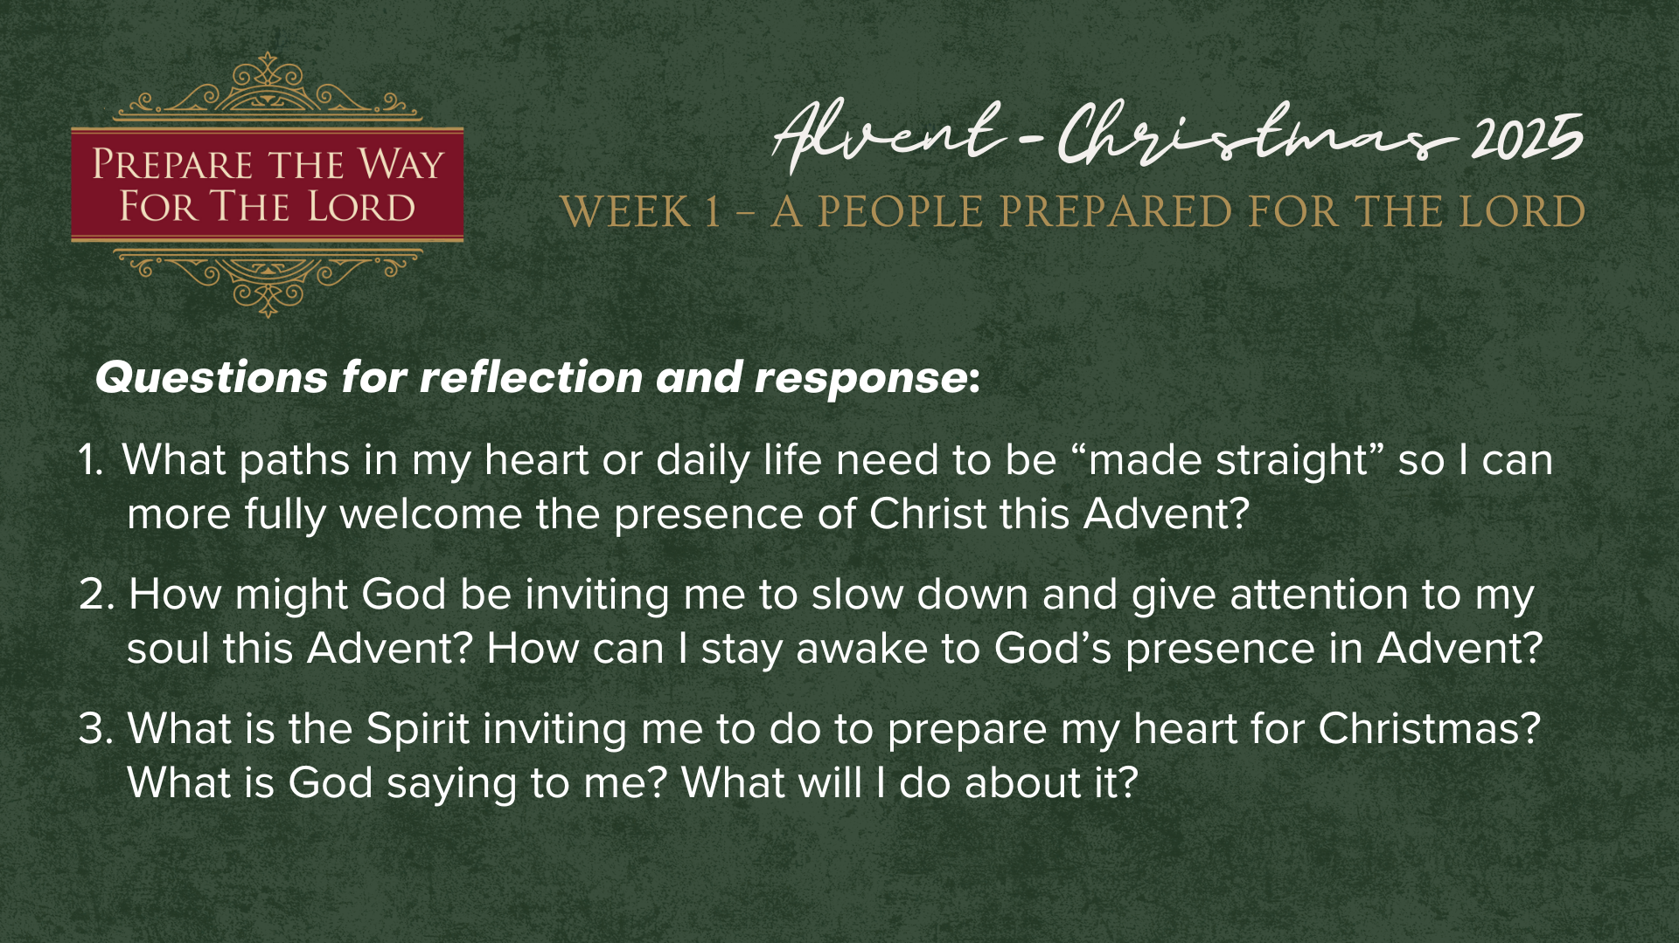
Notes:
[READ & COMMENT ON QUESTION]
3. What is the Spirit inviting me to do to prepare my heart for Christmas? What is God saying to me? What will I do about it?
Let’s pray… [NEXT SLIDE FOR CLOSING PRAYER]

Slide 18
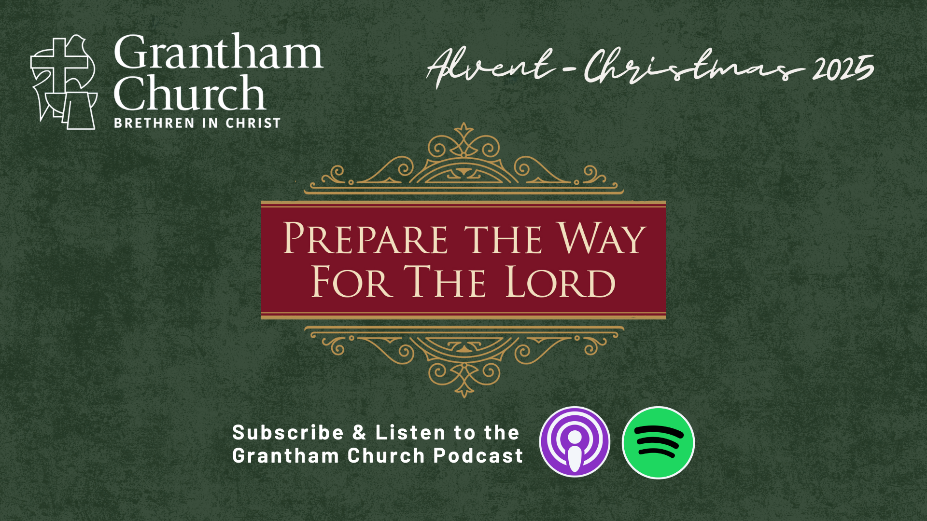
Notes:
[CLOSING PRAYER]
[CLOSING SONG]
Benediction
Go now as a people prepared for the Lord.
Walk in His grace, bear the fruit of His Spirit,
and shine with the light of Christ in all you do.
May the peace of God guard your hearts,
and may Christ increase in you—
today and always.
Amen.

